Slide 1

Fit And Fab Gym
GYM Management System
Cap . Sanket S. Ghaytadak = 230343120075
M . Bhushan R. Ahire = 230343120007
M . Ajay L. Kesale = 230343120008
M . Sharad R. Shinde = 230343120081

Slide 2
Gyms are the essential part of our lives, providing best exercise and body building facilities to our society
At the management end there are some necessary steps to maintain the records of every individual including trainer, gym members, and admin but maintaining the records on paper is very difficult
So it is necessary to have a computerized system that manages all these functionality. Thus working on the management system for gym industry is the basis of our project.
Problem Statement

Slide 3

Register user by itself
Book a membership
See workout plans + diet plans
AUD (add,update,delete) diet plan + workout plan by trainer
AUD (add,update,delete) membership plan by admin
AUD (add,update,delete) trainers access by admin
See members list By Admin
Project Objectives

Slide 4
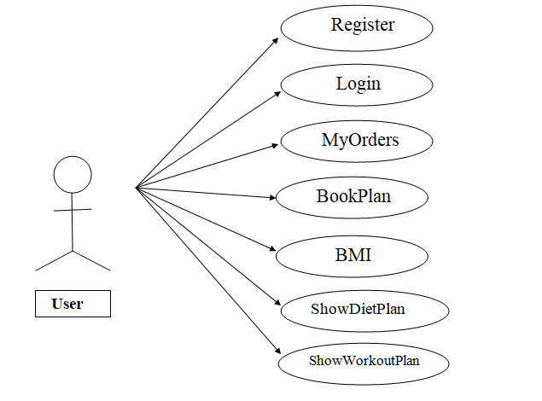
Role Of Services
User

Slide 5
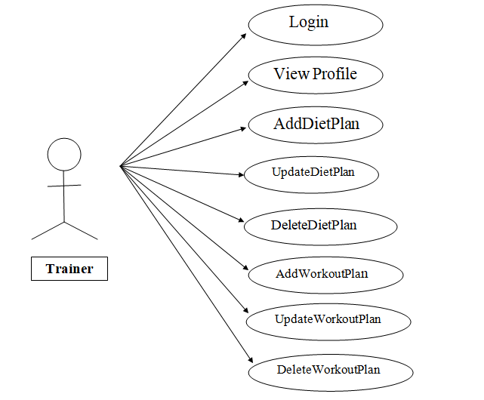
Role Of Services
Trainer

Slide 6
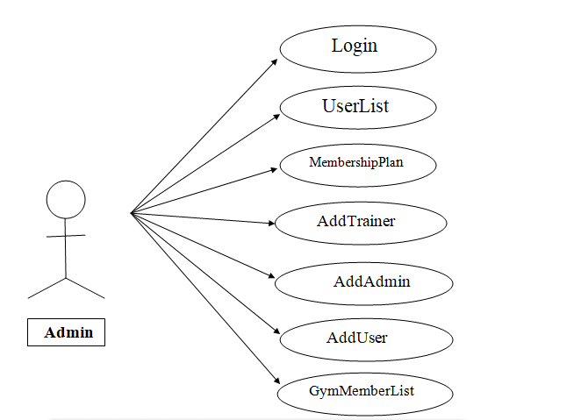
Role Of Services
Admin

Slide 7
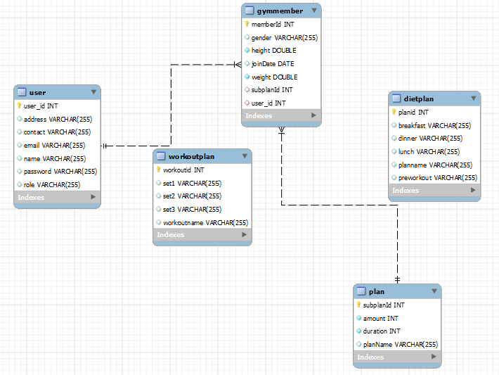
ER Diagram

Slide 8
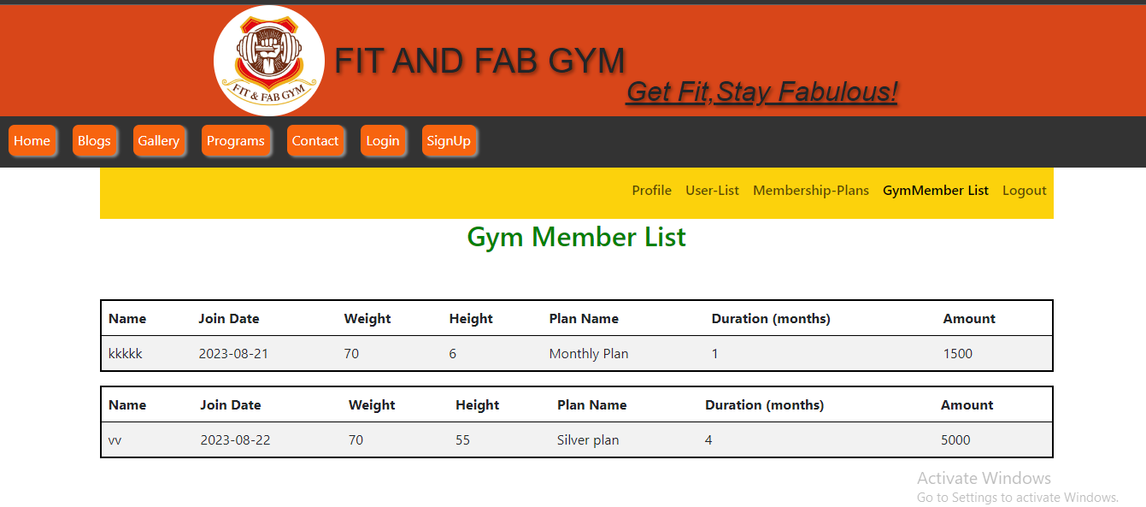
UI

Slide 9
Thank You…!

